Slide 1
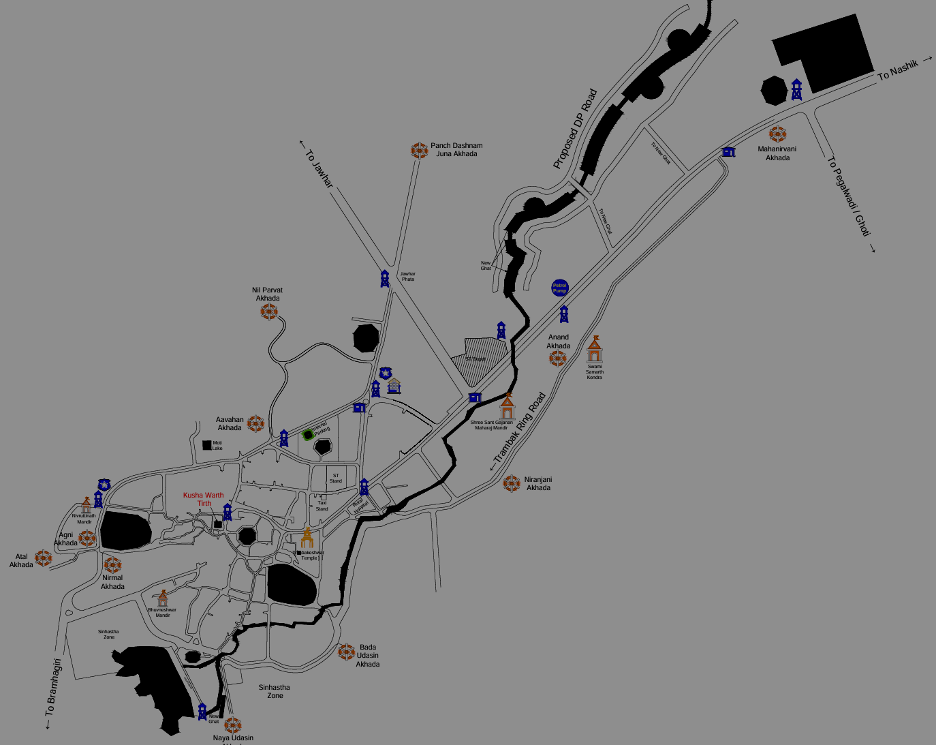
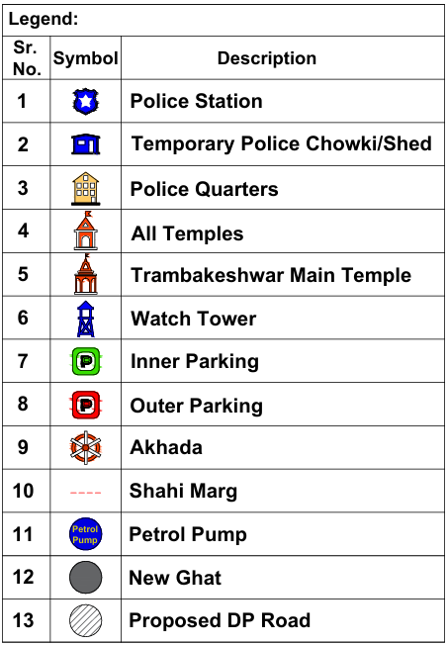
1. Shri Shambhu Panchdashnam Juna Akhada
Departure from Akhada: 11:00 PM
Khedarav Temple: 03:55 AM
Procession Start: 04:00 AM
Kushavarta Tirth: 04:45 AM
Departure from Kushavarta: 04:50 AM
Trimbakeshwar Temple: 05:00
Departure from Temple: 05:45 AM
Hospital Point: 05:55 AM
Arrival at Snan Ghat: 06:30 AM
Departure from Snan Ghat: 07:00 AM
Return to Akhada: 07:45 AM
Total Distance: 10 Km
अमृतस्नान मिरवणूक मार्ग -१
End - 7:45
Start - 11.00 PM
At Ghat –
6:30
2. Shri Panchayati Dashnam Avhan AKhada
Departure: 03:40 AM
Khanderav Temple: 03:55 AM
Procession Start: 04:00 AM
Kushavarta Arrival: 04:45 AM
Kushavarta Departure: 04:50 AM
Temple Arrival: 05:00 AM
Temple Departure: 05:45 AM
Snan Ghat Arrival: 06:30 AM
Snan Ghat Departure: 07:00 AM
Return: 07:30 AM
Total Distance: 4.60
End- 7:30
Start - 3:40
3. Shri Panch Agni Akhada
Departure: 03:35 AM
Khanderav Temple: 03:55 AM
Procession Start: 04:00 AM
Kushavarta Arrival: 04:45 AM
Kushavarta Departure: 04:50 AM
Trimbakeshwar Arrival: 05:00 AM
Temple Departure: 05:45 AM
Snan Ghat Arrival: 06:30 AM
Snan Ghat Departure: 07:00 AM
Return: 07:40 AM
Total Distance: 6.40
At Kushwart - 4:15
Start - 3:35
At Temple - 5:00 PM
End- 7:40
Total Hours – 8 Hr:40 min

